Slide 1

PROJECT 3:
Feature Extraction and Price Prediction for Mobile Phones
-ANIKET PATIL
DIGICROME ACADEMY

Slide 2

Slide 1: Problem Statement
Slide 2: Objective
Slide 3: Data Overview
Slide 4: Data Preprocessing
Slide 5: Exploratory Data Analysis (EDA)
Slide 6: Model Development
Slide 7: Model Evaluation
Slide 8: Results Visualization
Slide 9: Conclusion

Slide 3

PROBLEM STATEMENT
To find out a prominent organization that specializes in selling mobile phones. The organization is keen to enhance its pricing strategy by gaining a deeper understanding of the key features that influence the prices of mobile phones in today's highly competitive market.

Slide 4

To build a predictive model that can accurately estimate the price of a mobile phone based on its features. To achieve this, you'll perform a feature extraction analysis to identify the most influential features

Slide 5

DATA OVERVIEW
Uploading Dataset
Dataset: Processed_Flipdata.csv-
Key Features: - Memory, RAM, Battery, Camera Pixels - Categorical Features: Model, Colour, Processor-
Target Variable: Prize

Slide 6

DATA PRE-PROCESSING
Load and Clean the Dataset: Load the dataset, drop unnecessary columns, and handle missing values.
Convert Prize to Numerical: Clean the Prize column by removing commas and converting it to integers.
Remove Outliers: Use the IQR method to remove outliers from numerical columns.
Convert Categorical Variables: Use one-hot encoding for categorical variables.
Feature Extraction: Extract new features from existing ones (e.g., camera pixels from camera descriptions).

Slide 7
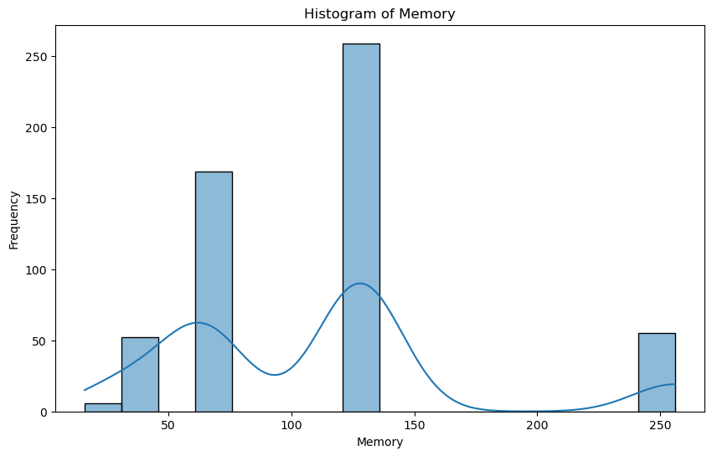
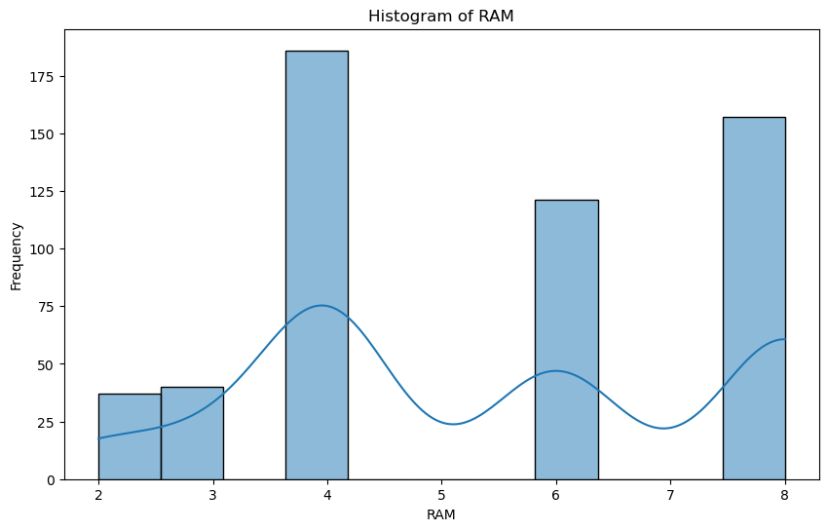

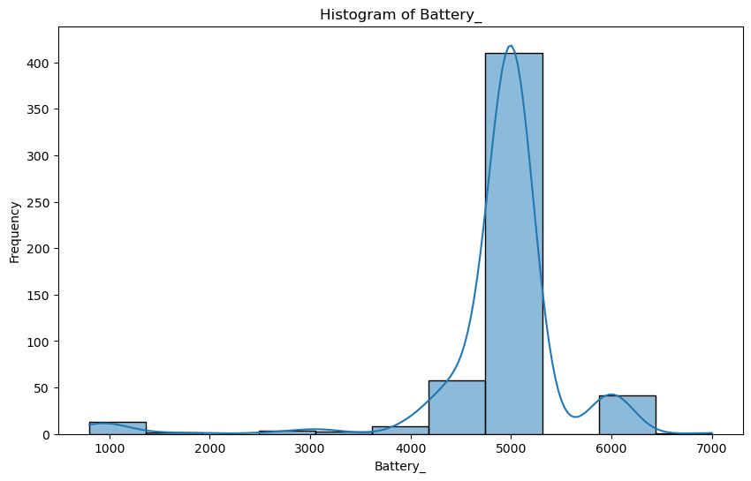
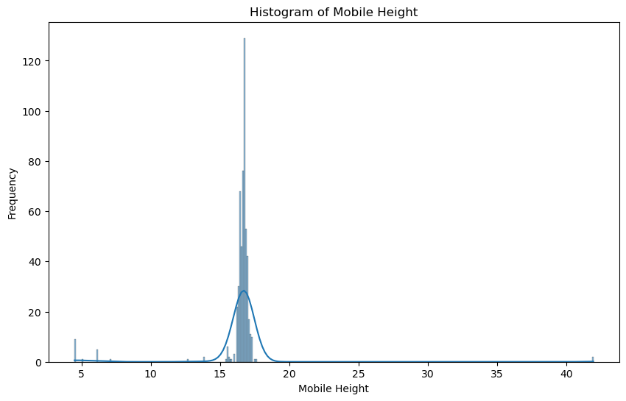
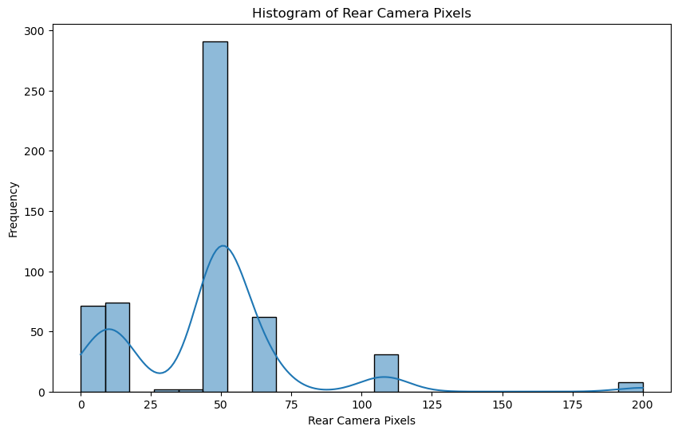
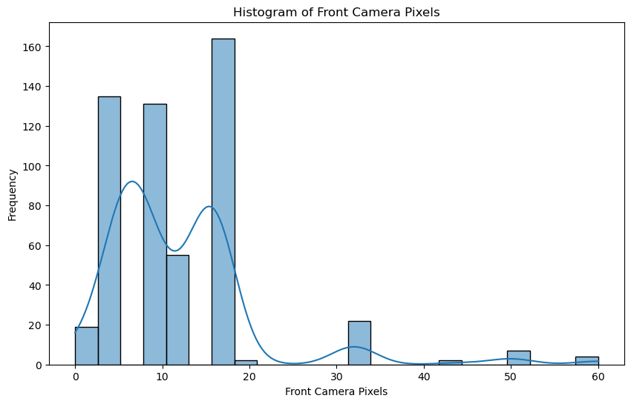
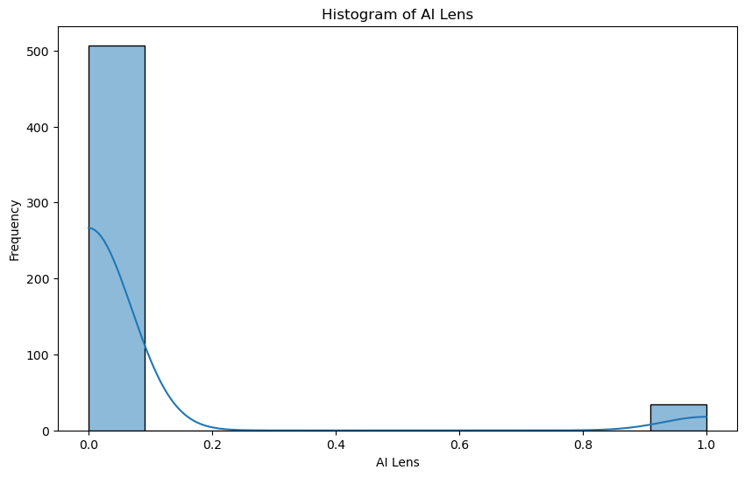
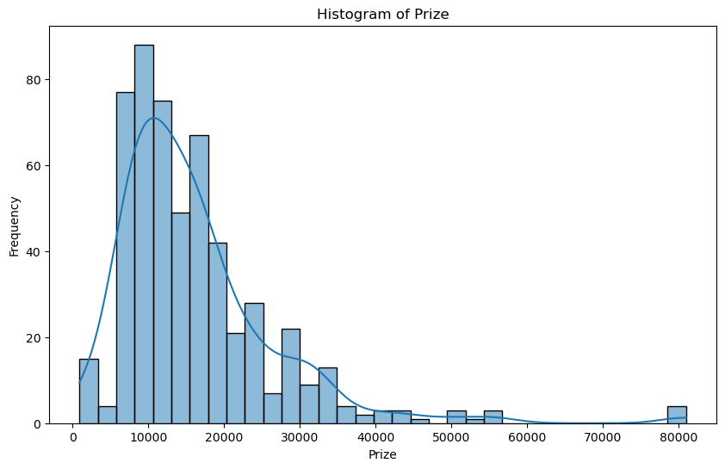
EDA
Histograms for continuous and discrete columns

Slide 8
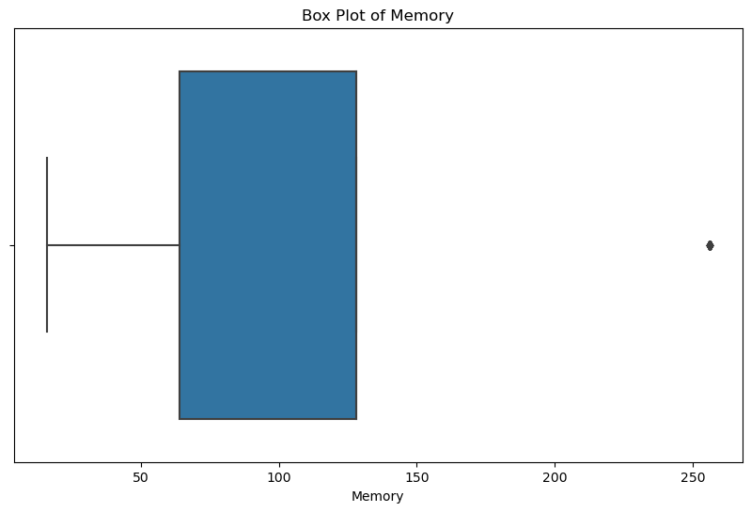
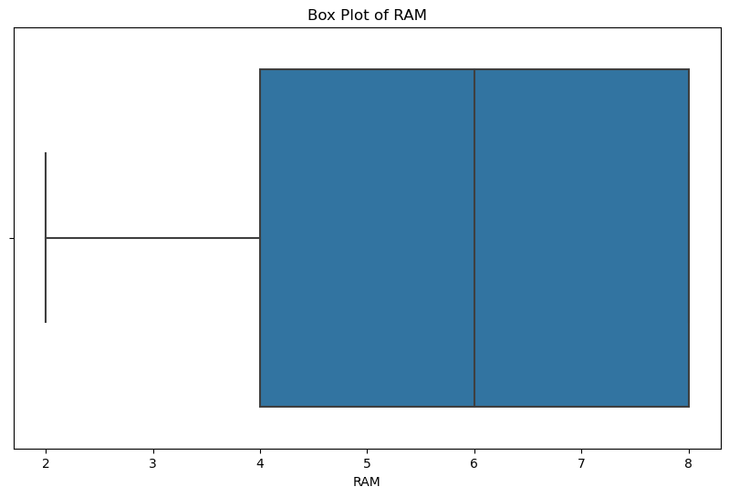
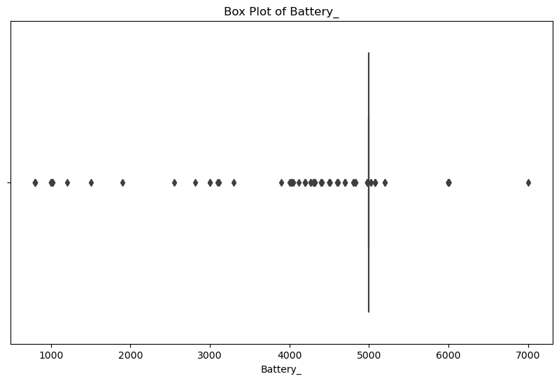
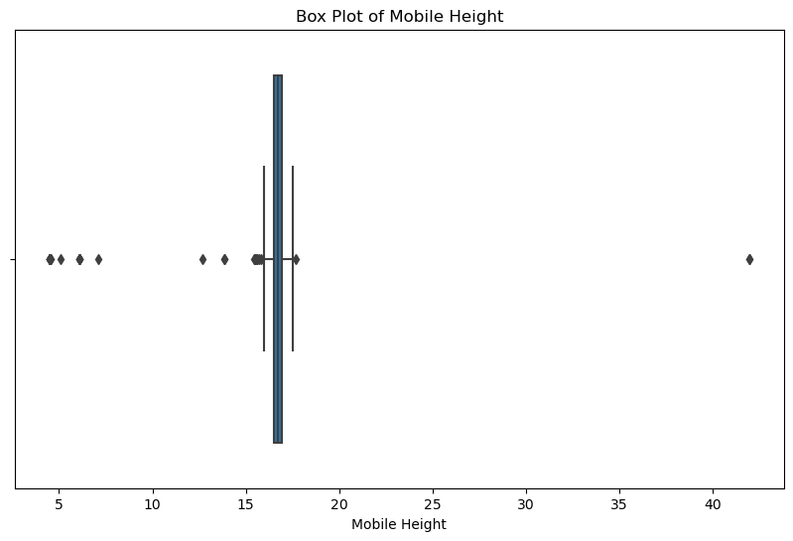
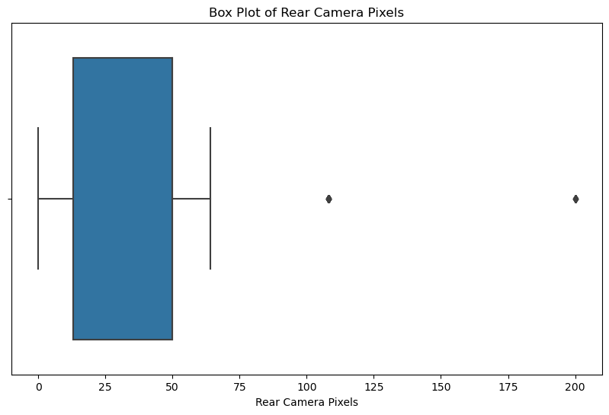
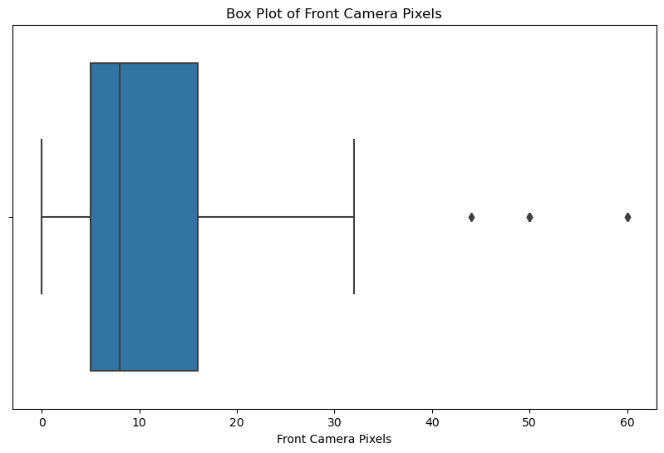
Box plots for continuous columns

Slide 9
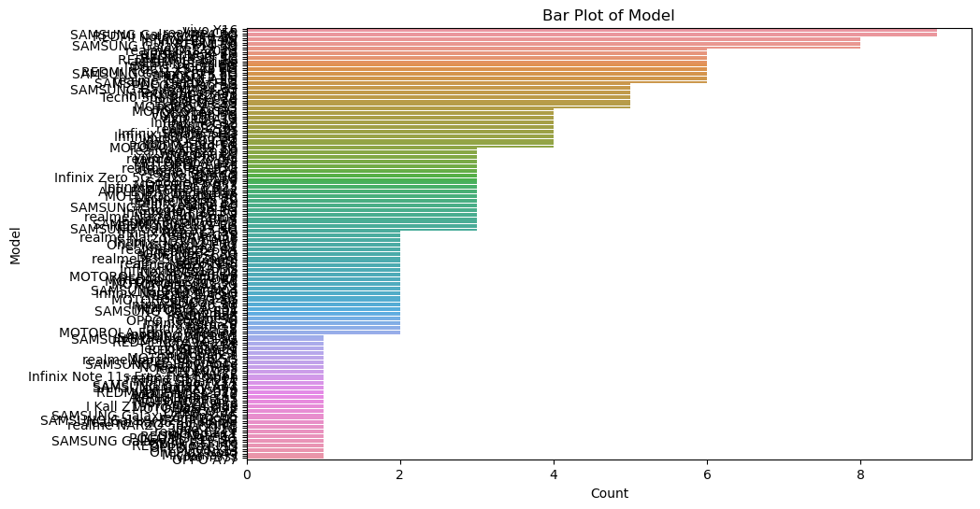
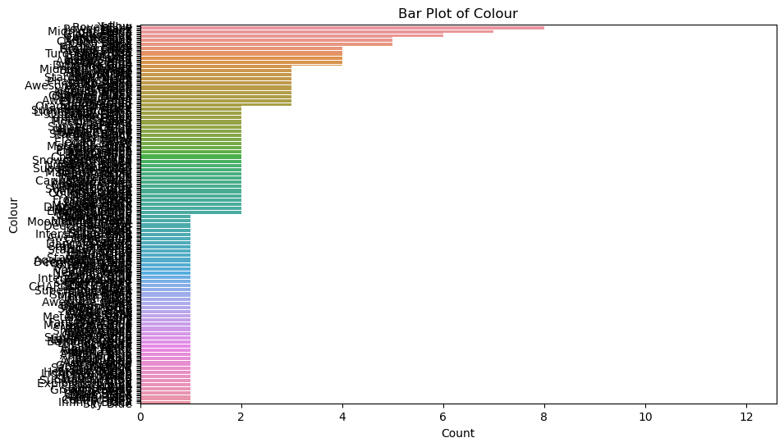
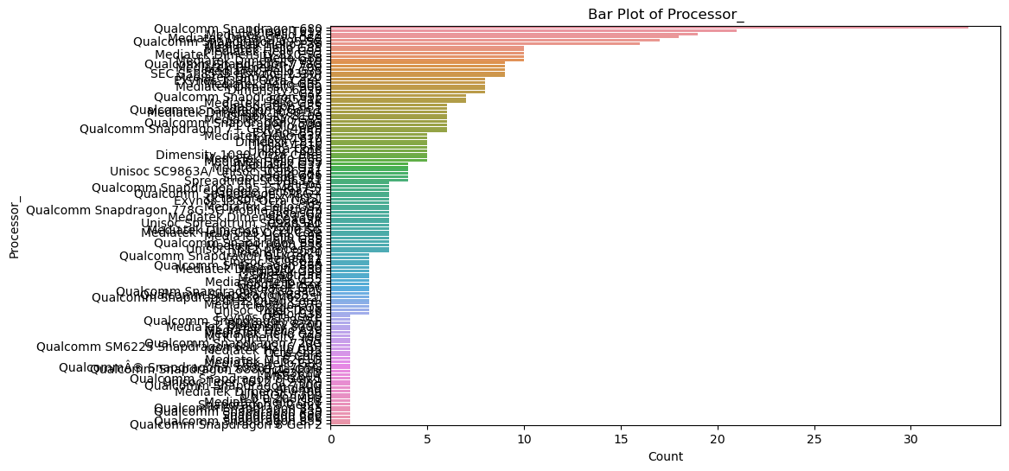
Bar plots for categorical columns

Slide 10
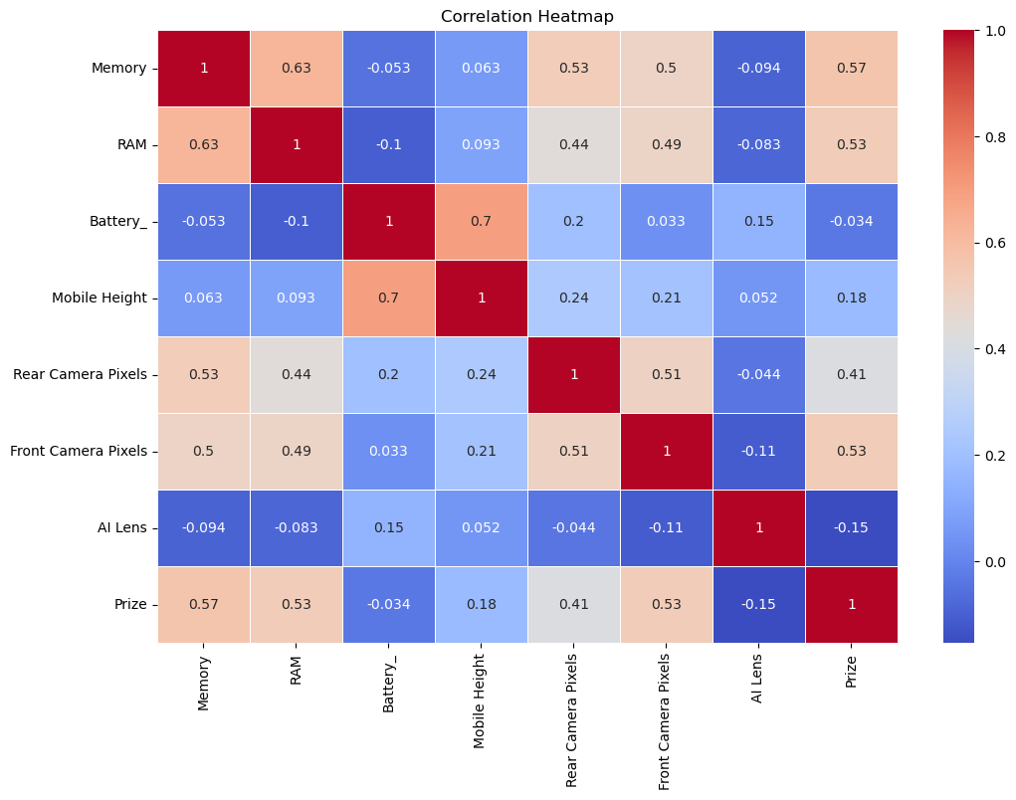
Heatmap for correlation between numerical features

Slide 11
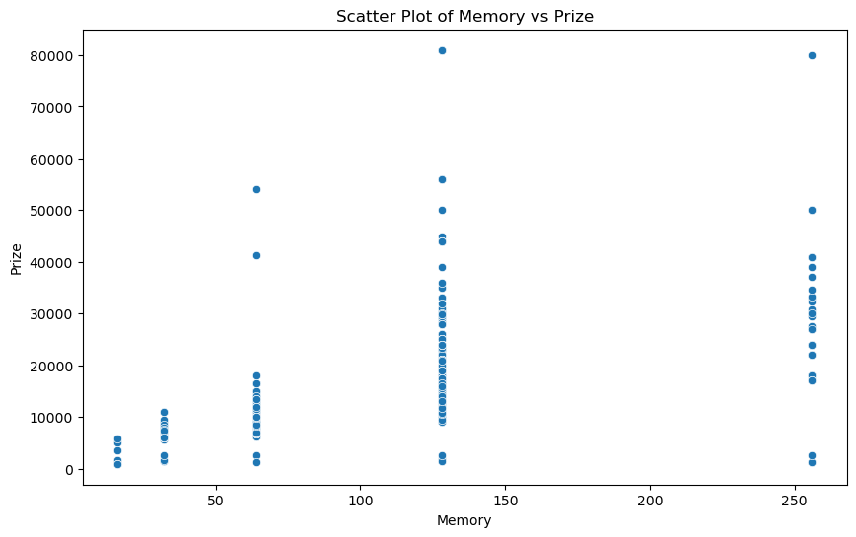
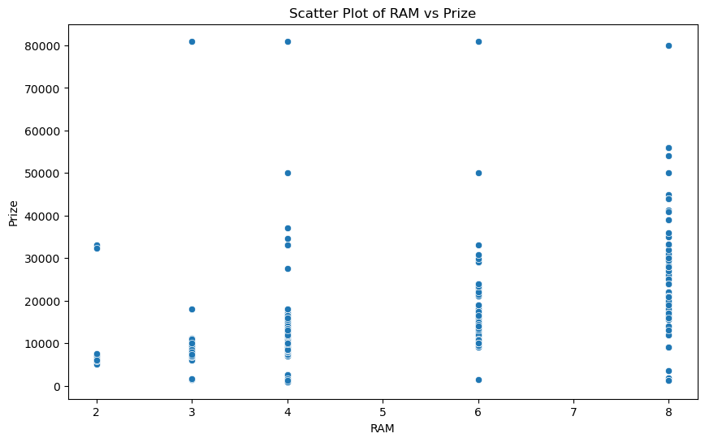
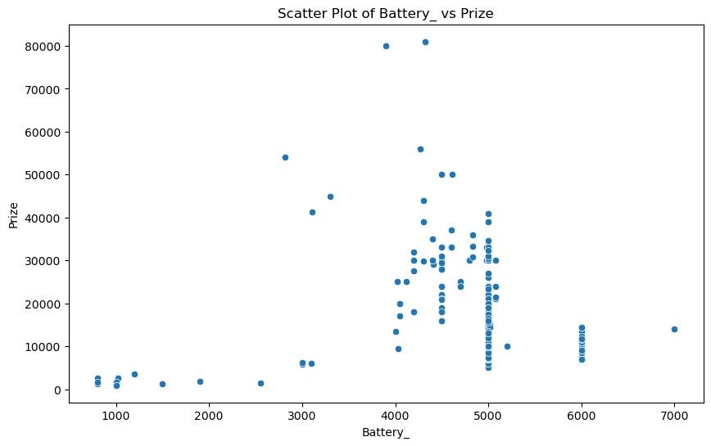
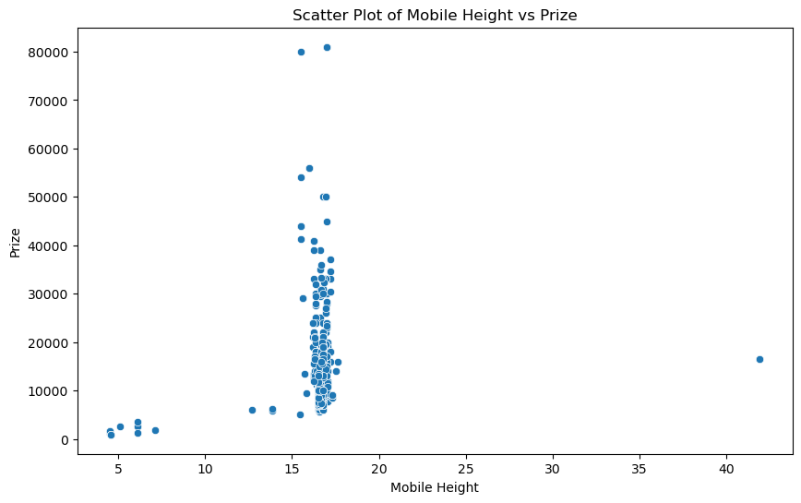
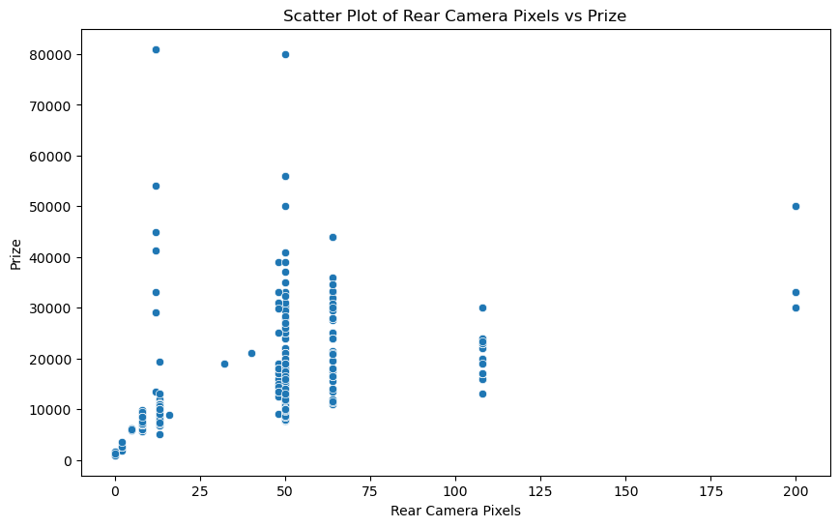
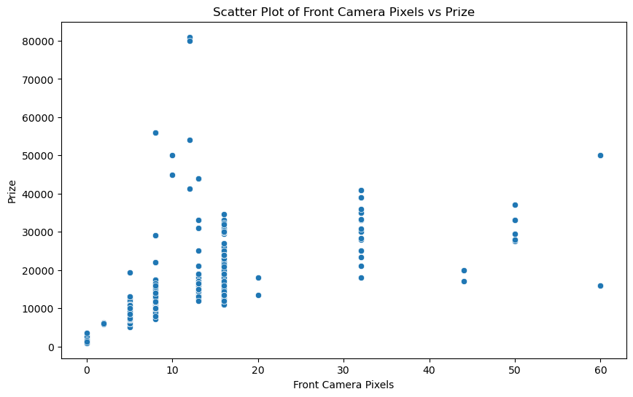
BIVARIATE ANALYSIS

Slide 12

MODEL DEVELOPMENT
Train-Test Split: The dataset was divided into training (80%) and testing (20%) subsets.
Standardization: Features were standardized to improve model performance.
Model Selection: Random Forest Regressor was chosen for its ability to manage non-linear relationships and interactions between features.

Slide 13

MODEL EVALUATION
Performance Metrics: - Mean Absolute Error (MAE): X (669.774)
Mean Squared Error (MSE): Y (866402.292)
Root Mean Squared Error (RMSE): Z (930.807)
R² Score: W (0.95)-
Interpretation: The metrics indicated a strong predictive capability of the model, with an R² score close to 1 signifying good fit.

Slide 14
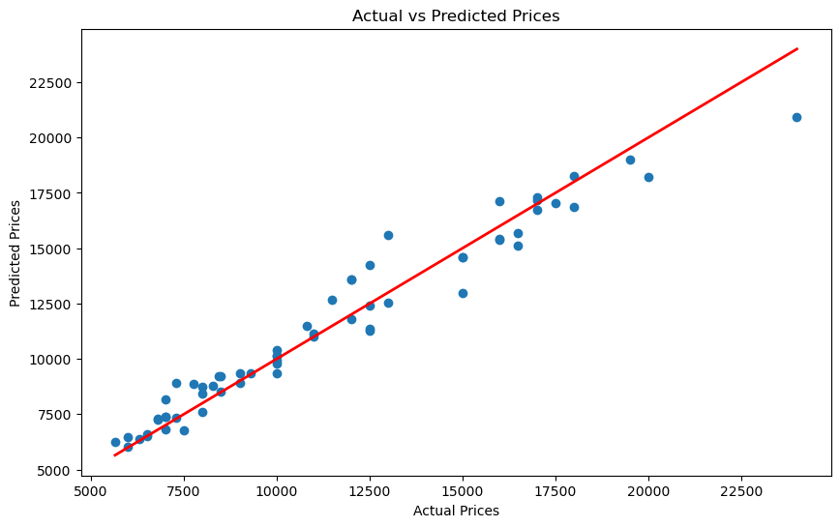

RESULT VISUALIZATION
Actual vs. Predicted Prices*: A scatter plot was created, showcasing the model's predictions against actual prices, demonstrating a close alignment.

Slide 15

In the mobile price prediction project using the specified dataset, the model predicts the price based on the following features like,
- RAM: Amount of random-access memory.
Memory: Internal storage capacity.
Battery Capacity: Power capacity of the battery.
Rear Camera Pixels: Quality of the rear camera in megapixels.
Front Camera Pixels: Quality of the front camera in megapixels.
Processor Type: Type and speed of the mobile processor.
Mobile Height: Physical height of the mobile device.
AI Lens: Indicates the presence of AI-enhanced camera features.
Model: Specific model name of the mobile device.
Color: Available color options of the mobile device.
These parameters collectively influence the pricing model, as they encapsulate the core aspects of mobile technology and consumer preferences, leading to variations in market pricing.
The Random Forest model effectively predicts mobile phone prices based on various features.
CONCLUSION

